Slide 1
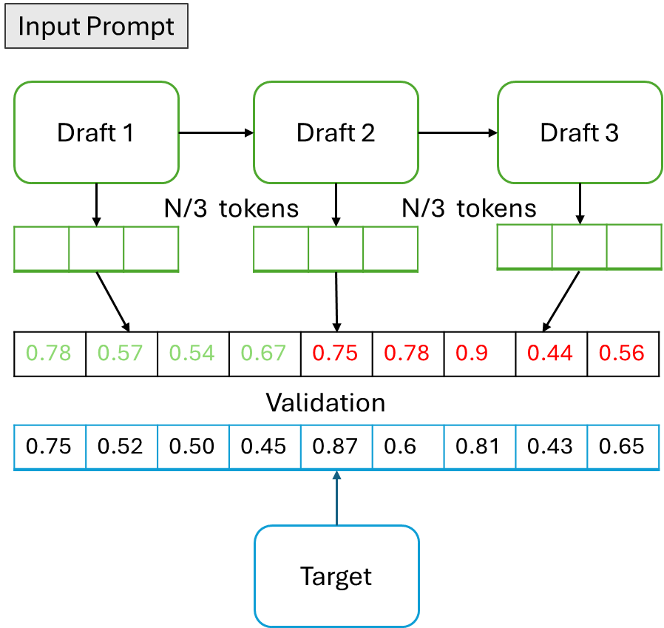
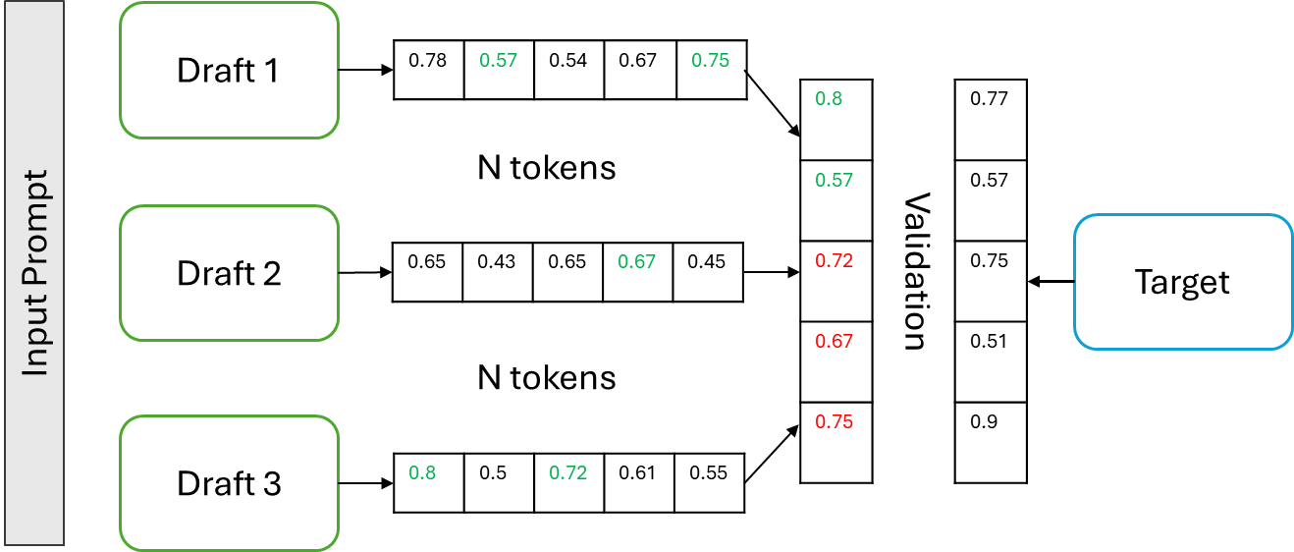

Slide 2
Input Prompt
Draft 1
Draft 2
Draft 3
N/3 tokens
N/3 tokens
0.78 | 0.57 | 0.54 | 0.67 | 0.75 | 0.78 | 0.9 | 0.44 | 0.56
Validation
0.75 | 0.52 | 0.50 | 0.45 | 0.87 | 0.6 | 0.81 | 0.43 | 0.65
Target

Slide 3
Draft 1
0.78 | 0.57 | 0.54 | 0.67 | 0.75
0.8
0.57
0.72
0.67
0.75
0.77
0.57
0.75
0.51
0.9
N tokens
Draft 2
Target
Input Prompt
0.65 | 0.43 | 0.65 | 0.67 | 0.45
Validation
N tokens
Draft 3
0.8 | 0.5 | 0.72 | 0.61 | 0.55

